Slide 1
Minerals
By: Sara S Mohammed
Department of Veterinary Public Health
College of veterinary medicine university of Basrah
University of Basrah- College of veterinary medicine- Department of Veterinary Public Health

Slide 2
Minerals
The term essential mineral element is restricted to a mineral element that has been proven to have a metabolic role in the body. Thirteen mineral elements were classified as essential depends upon their concentration in the animal or amounts required in the diet, these classified as:
A- Major elements
(calcium, phosphorus, potassium, sodium, chlorine, sulphur, magnesium)
B- Micro or trace elements
(iron, iodine, copper, manganese, zinc and cobalt).
Normally trace elements are present in the animal body in a concentration not greater than 50 mg/kg and are required at less than 100 mg/kg diet.
Table (1) Nutritionally important essential mineral elements and their approximate concentration in the animal

Slide 3
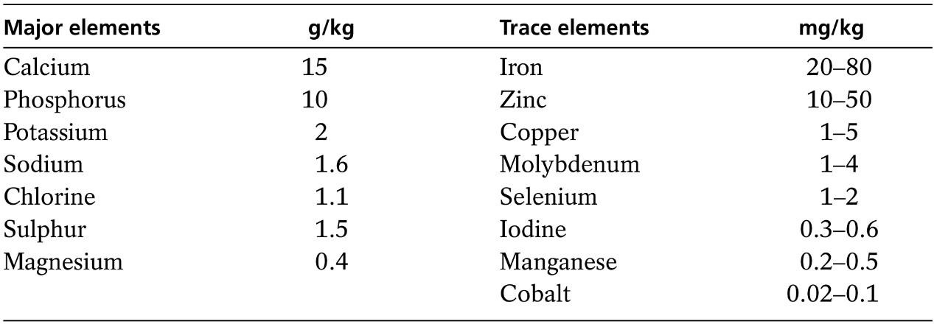
Table (1) Nutritionally important essential mineral elements and their approximate concentration in the animal.

Slide 4
Mineral Functions:
Catalytic functions
Some mineral elements are firmly bound to the proteins of enzymes , while others are present in prosthetic groups in chelated form. A chelate is a cyclic compound that is formed between an organic molecule and a metallic ion, chelate is derived from the Greek work meaning ‘claw. There are two types of chelates :
Natural chelates such as chlorophylls, cytochromes, hemoglobin and vitamin B12.
Synthetic chelates such as EDTA .

Slide 5
2-Physiological functions sodium, potassium and chlorine concerned with the maintenance of acid–base balance, membrane permeability and the osmotic control of water distribution within the body. 3-Structural functions calcium and phosphorus are essential components of the skeleton and sulphur is necessary for the synthesis of structural proteins. 4-Regulatory functions in controlling cell replication and differentiation; zinc acts in this way by influencing the transcription process, in which genetic information in the nucleotide sequence of DNA is transferred to that of an RNA molecule. A number of elements have unique functions. Iron is important as a constituent of haem, which is an essential part of a number of cytochromes important in respiration. Cobalt is a component of vitamin B12 and iodine forms part of the hormone thyroxine.

Slide 6
Mineral Interaction:
The interaction of minerals with each other is an important factor in animal nutrition, and an imbalance of mineral elements is important in the etiology of certain nutritional disorders of farm animals. Many minerals are toxic causing illness or death if given to the animal in excessive quantities. Therefore, supplementation of any diet with minerals should always be carried out with great care, the supplement should be tailored to the target animal and oversupply should be avoided as it is wasteful and dangerous.
There are many ways in which minerals may interact, but the three major ways involve:
the formation of un-absorbable compounds.
competition for metabolic pathways.
the induction of metal-binding proteins.

Slide 7
Supplementary Sources Of Minerals:
Plants and plant products form the main supply of nutrients to animals, factors influence the animal’s mineral intake are :
the composition of plants
the species and stage of maturity of the plant
the type of soil and fertilizer application
climate and the seasonal conditions
The main animal products used in animal feeding considered good sources of the major minerals are :
Fishmeal
whey
skimmed milk
When considering sources of mineral we take into account the following :
Cost
chemical and physical form
the availability of the element

Slide 8
There are four categories of metal complex; Metal amino acid complex Metal amino acid chelate Metal polysaccharide complex Metal proteinate
Acid – Base Balance
diet is important in the maintenance of the intracellular electrolyte balance owing to the metabolizable anions and cations that it contains and that consume or generate acid during metabolism. Thus, an excess of anions will result in the production of hydrogen ions to counterbalance the anions, giving metabolic acidosis, whereas an excess of cations requires ions such as acetate and bicarbonate and causes alkalosis.
The balance of acids and bases influences many functions such as:
growth rate
appetite
amino acid metabolism
energy metabolism
calcium utilization
vitamin metabolism
intestinal absorption
kidney function.

Slide 9
List of minerals commonly added to animal feed, either directly or as additives in compound feed;
:Calcium (Ca): Essential for bone and tooth formation, as well as for muscle contraction and blood clotting. It is found in ingredients such as bone meal, calcium carbonate, and dicalcium phosphate.
Phosphorus (P): Important for bone and tooth formation, and plays a key role in energy production. It is found in ingredients such as dicalcium phosphate, monocalcium phosphate, and bone meal
.Magnesium (Mg): Essential for neuromuscular function and energy metabolism. It is found in ingredients such as magnesium oxide and magnesium sulfate.
Zinc (Zn): Essential for growth, reproduction and immune function. It is found in ingredients such as zinc oxide and zinc sulfate
.Iodine (I): Essential for the production of thyroid and growth hormones. It is found in ingredients such as calcium iodate and potassium iodide.
Selenium (Se): Important for antioxidant function and reproduction. It is found in ingredients such as sodium selenite and selenium-rich yeast.

Slide 10
Potassium (K): Essential for muscle function, acid-base balance and osmotic regulation. It is found in ingredients such as potassium chloride and potassium sulfate.Sodium . (Na): Important for fluid balance and nerve function. It is found in ingredients such as sodium chloride (table salt Chlorine (Cl): Essential for acid-base balance, nerve function, and digestion. It is found in ingredients such as sodium chloride and potassium chloride .Iron (Fe): Essential for hemoglobin production and immune system function. It is found in ingredients such as ferrous sulfate and iron oxide .Copper (Cu): Essential for hemoglobin production and connective tissue formation. It is found in ingredients such as copper sulfate and copper oxide. Manganese (Mn): Important for skeletal growth and reproduction. It is found in ingredients such as manganese oxide and manganese sulfate.

Slide 11
THAK YOU FOR YOUR LISTENING

